Slide 1
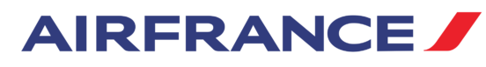


Digital Marketing Optimization Strategy
2008 Internet Marketing Analysis
Cohort 5, Team 8:
Arjun Banerjee, Evgenii Agenko, Francisco Luna,
Julia Grala, Monika Isahakyan and Yinze Wu
Date: 12/03/2019

Slide 2

Agenda
Overview
2007 digital results
Digital Marketing Challenges
Operational Analysis
Publisher Effectiveness
Campaign and keyword
Next Steps
Keyword Performance Tool
New Partnerships
Conclusion
Notes:
Our agenda will have an overview of the previous year’s digital marketing results and its challenges
We will then move on to the Operational Analysis to understand key patterns that would give us significant insights
Finally, our next steps would include a strategic plan that can increase Air France’s market growth and profitability in the near future.

Slide 3
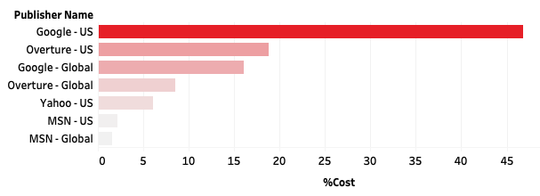


Digital Marketing 2007
SE Budget Share
Keywords 4511
Campaigns 23
Publishers 4
60% budget
Google keywords
Profits
$ 3.9M
Costs
$ 0.7M
Notes:
Based on the previous year’s data, we have compared the total costs towards each Search Engine and we see that Google - US has the highest Budget share with about 60% of the total costs of click charges
Assessing the data we implemented more than 4500 keywords and about 23 Campaigns
The total costs accumulated was about 700,000 dollars with an upward profit of about $4M

Slide 4
Key Performance Indicators
Return on Advertising (ROA)
Average Cost Per Click
(CPC)
Conversion Rate
Profit
Notes:
What are the most important KPIs, and what impact will campaign changes have on these KPIs?

Slide 5
Digital Marketing Challenges
8% keywords
generated Sales
12% of those
negative return
ROA 7.3 for
profitable keywords
$190K spent in
No-return keywords
Notes:
Challenges we found when analyzing data

Slide 6
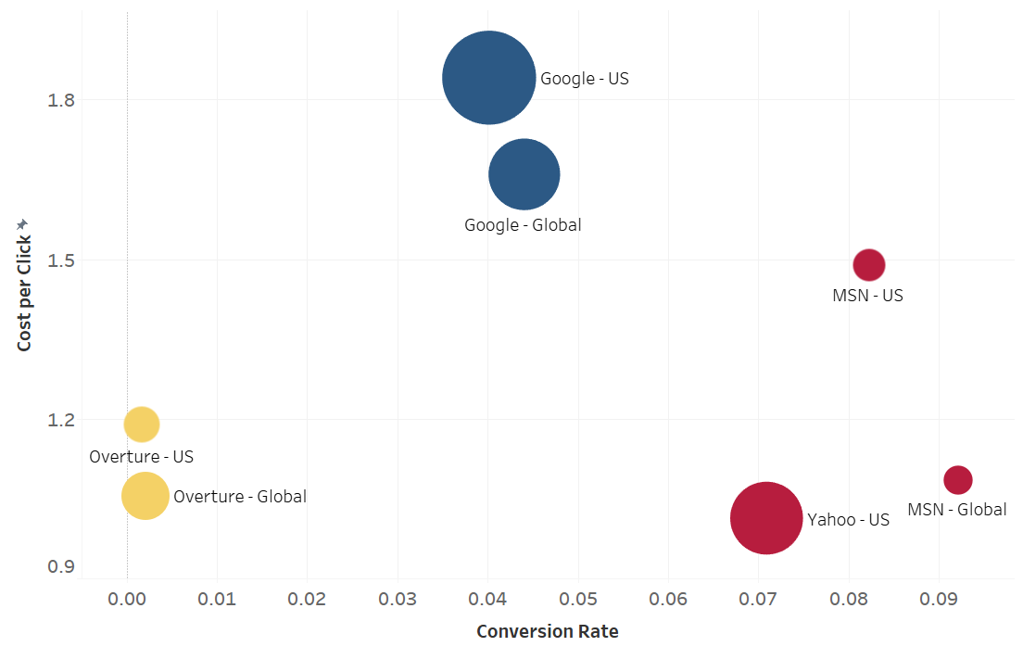
Publisher Effectiveness Analysis
MSN and Yahoo are the most efficient
MSN and Overture have lowest profits
Most US campaigns were run on Yahoo and Google
Size: Profits
Notes:
Analysing the investments of 2007, we can see that MSN US and Global, as well as Yahoo had higher conversions rate and lower costs per click
Profit wize, Google and Yahoo had higher average tickets purchases and returned more profit
Overture ranked in lowest position, not demonstrating profitability
But these metrics are not enough to understand what is happening here, for that we have to understand the campaigns that were runned here

Slide 7
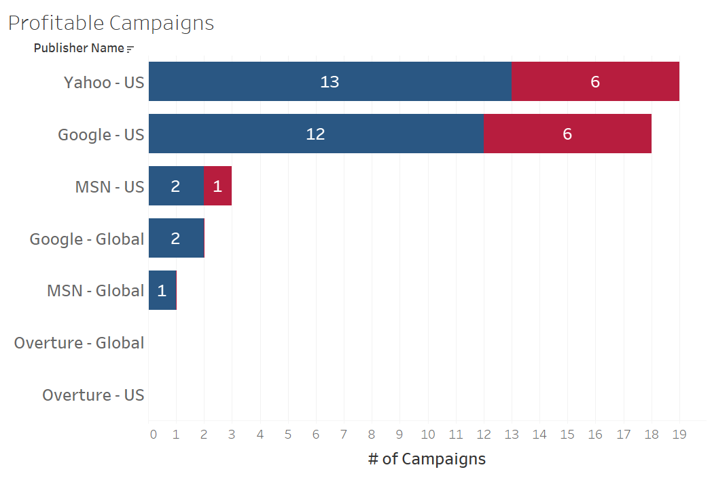

Campaign Success Analysis
Choice of Publisher influences success
MSN with few campaigns assigned
One US targeted campaign was run on MSN
Notes:
We ran 23 campaigns in 2007
The majority was in United States and specifically Yahoo and Google, which explains why the profit was higher in these two publishers
MSN US was used for 3 campaigns and Global only for 1
Given that MSN had a higher ROA per campaing, this choice needs to be re-evaluated

Slide 8
Campaign Lever to increase ROA
1#
Publisher Choice

Slide 9
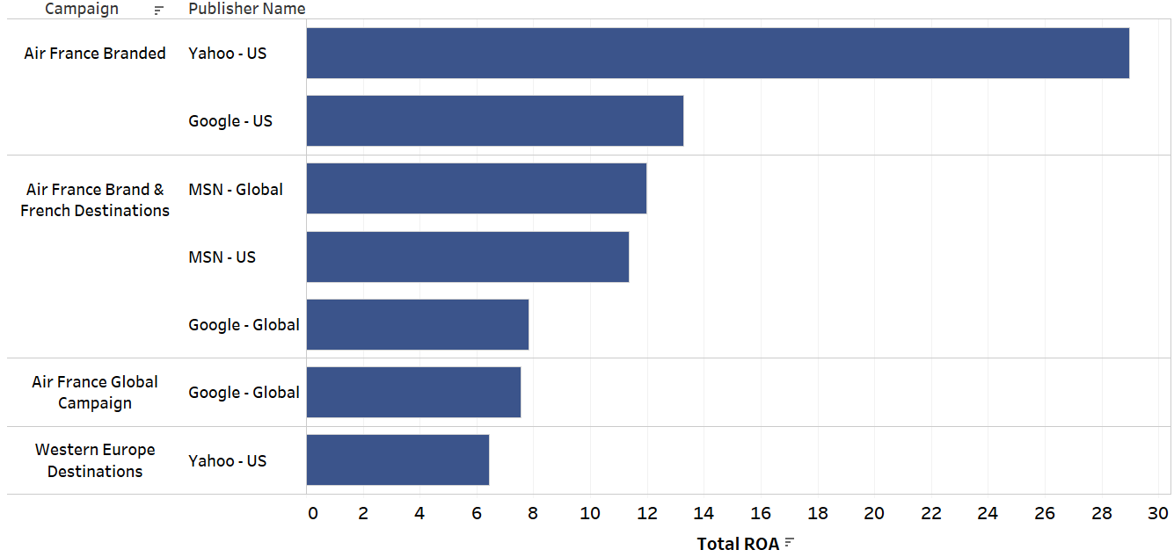
New Campaigns for MSN
Run on MSN:
Air France Branded
Air France Global
Western Europe Destinations
US geo targeted campaigns
Notes:
Number of campaigns that we have for each provider and talk about number of profitable campaigns and what to do with them(remove)
MSN has higher ROA than google for this campaign so we suggest to try the same campaign in MSN , we should put the other ones that work well in MSN

Slide 10
Campaign Lever to increase ROA
1#
Publisher Choice
2#
Keywords Match Type
Notes:
How can campaigns be improved to increase overall value gained from investment with a search engine publisher? Should keywords be added or dropped from the campaign? Should campaign tactics or copy be adjusted to improve campaign performance?
Broad or exact match types of keywords ?
On the pivot table analyse best campaigns based on:
Average ticket
Profit
ROA
Prob of purchase
What they have in common:
Which channel
Which keywords
As conclusion, what are the general characteristics we can apply to campaigns
Then analyse the key words inside of the campaign, what should be dropped
In which channels the campaign would be more profitable

Slide 11
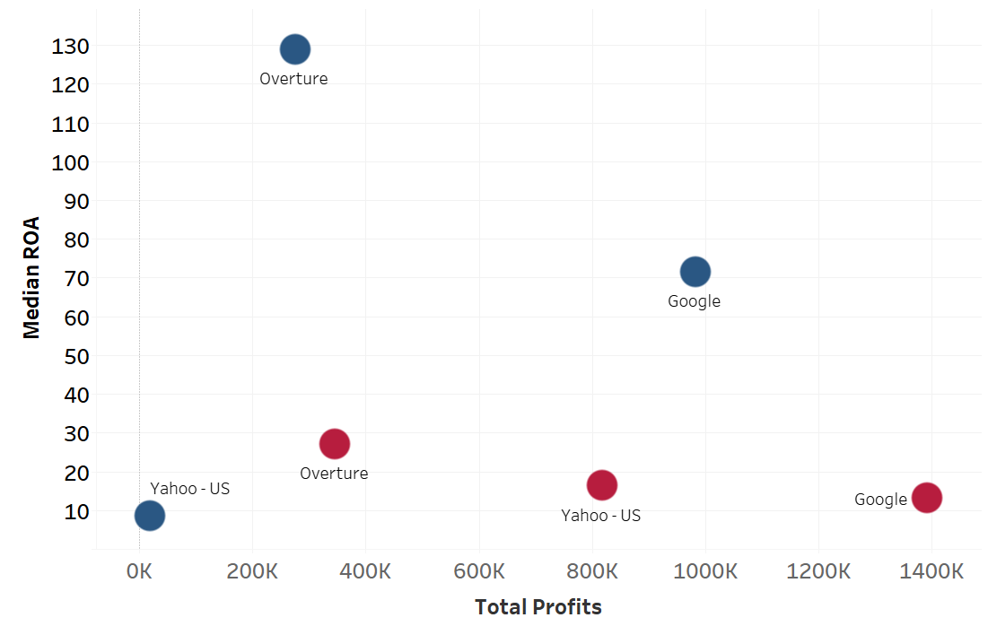

Match Type Influence
Google: Broad and Exact balanced in Profits and Efficiency
Overture: Exact keywords generate the same profit with a higher ROA
Yahoo: Broad keywords generate higher profits with a similar ROA
Notes:
How can campaigns be improved to increase overall value gained from investment with a search engine publisher? Should keywords be added or dropped from the campaign? Should campaign tactics or copy be adjusted to improve campaign performance?
Massive for google
Focus keyword on overture
Compare to overture, yahoo has higher profit

Slide 12
Campaign Lever to increase ROA
1#
Publisher Choice
2#
Keywords Match Type
3#
Keyword Group
Notes:
How can campaigns be improved to increase overall value gained from investment with a search engine publisher? Should keywords be added or dropped from the campaign? Should campaign tactics or copy be adjusted to improve campaign performance?
On the pivot table analyse best campaigns based on:
Average ticket
Profit
ROA
Prob of purchase
What they have in common:
Which channel
Which keywords
As conclusion, what are the general characteristics we can apply to campaigns
Then analyse the key words inside of the campaign, what should be dropped
In which channels the campaign would be more profitable

Slide 13
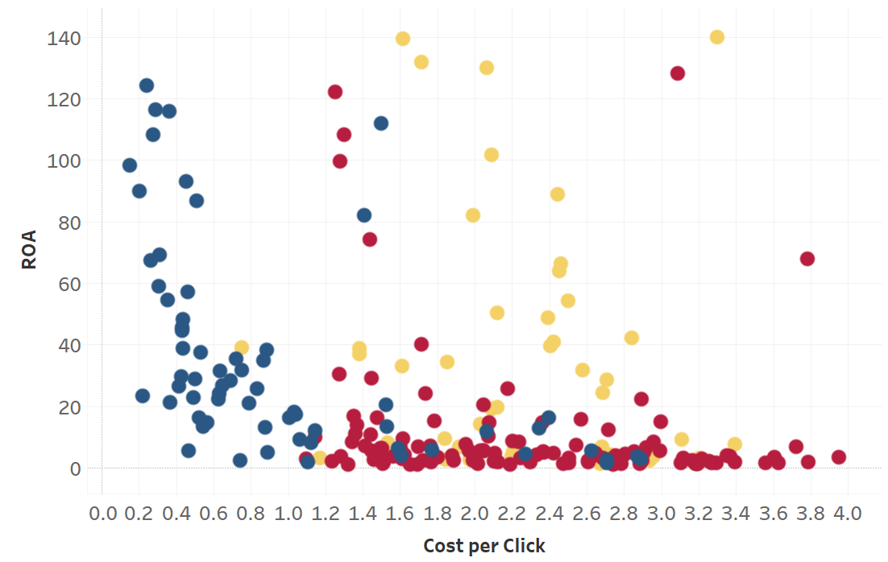
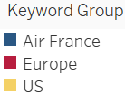
Keyword Group Influence
High ROA and low CPC for Air France keywords
Low ROA and high CPC for Europe destination
High competition in Europe
US campaigns are scattered with uneven results
Notes:
How can campaigns be improved to increase overall value gained from investment with a search engine publisher? Should keywords be added or dropped from the campaign? Should campaign tactics or copy be adjusted to improve campaign performance?
Branded keyword of airfrance,
Europe destination has many cpc but no transfer to revenue

Slide 14
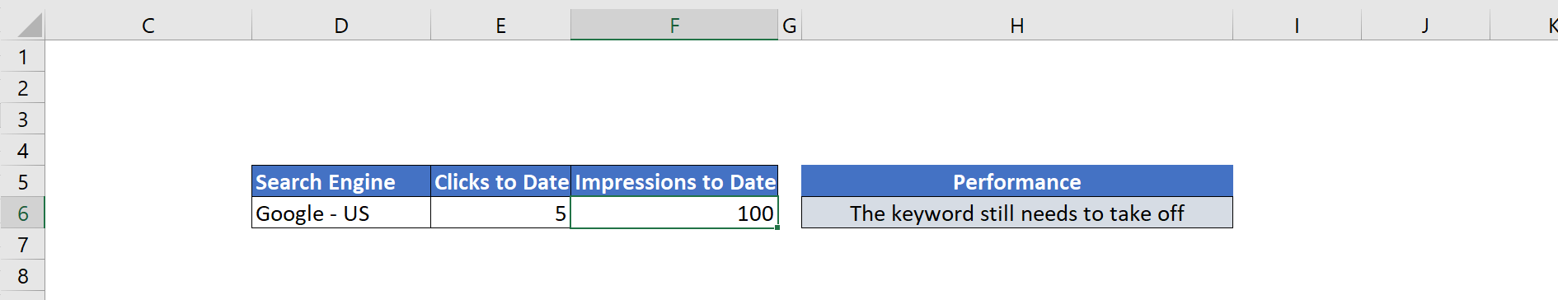
Measuring Keyword Potential
What if we could predict a Keyword effectiveness during the first days of the campaign?
Thanks to Data Analytics we can!
Notes:
CODE: Kayak comparison with other channels using the metrics that are already available at the excel
CHART: bubble

Slide 15
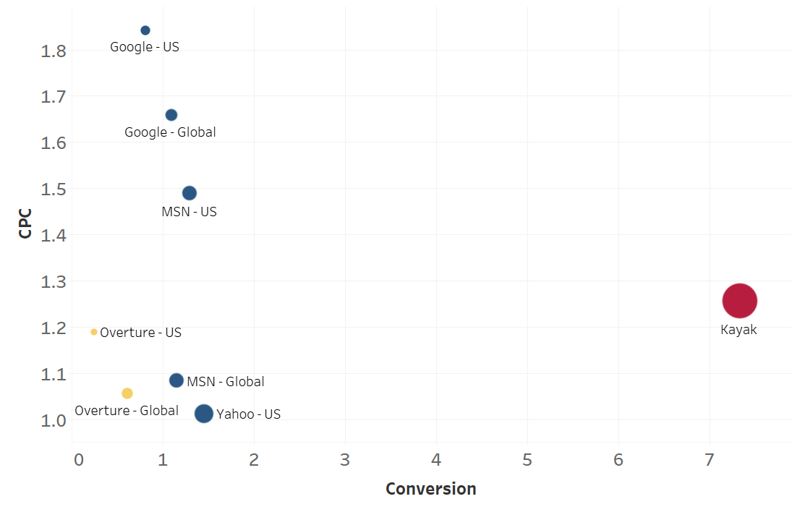
Potential Partnership: Kayak
Kayak has significantly higher conversion rate and ROA with and intermediate CPC
There is only one week of data, so testing with few campaigns is recommended
Size: ROA
Notes:
The digital workspace is constantly changing and the search platforms now are sharing space with aggregators and metasearch websites
We run a test of one week in one of the agregator website Kayak and the results were positive
As you can see they had high conversion rate with a low cost per click,
In the following year we would run extra tests with Kayak and other aggregators to understand how profitable this could be, create partnerships with them

Slide 16
Strategy drivers
1 Increase campaigns in MSN and Yahoo
2 Reduce spending in Overture and run structured campaigns
3 Taylor campaigns for each publishers - match type and group
4 Work on pricing strategy for Europe destinations
5 Allocate more budget to aggregator and metasearch sites
Notes:
To summarize everything discussed, here are main key points for strategy:
First of all we need to try running more campaigns in MSN and Yahoo and Reduce our investment with Overture
When running campaigns we need to taylor keyword match type and group with each campaign
Next,As the insights shows, to generate more profit we need to work on pricing strategy for European flights as there is a high competition there.
And finally, we need to test more campaigns in aggregator and metasearch sites, which will be another way of attracting new customers and generate moreRevenue

Slide 17
Next steps
New keyword list approval
Campaign placement approval
Promotion testing and comparison

Slide 18
Marketing Strategy for 2008
Search Engine Market Share
Keywords 4511
Campaigns 24
Publishers 4
Net Revenue $ 3,9 million
Costs $ 755 thousand
Required Budget
Notes:
key words, campaings, revenue, costs for the year

Slide 19
Digital Marketing Optimization Strategy 2008

